Slide 1
AMSATSA 2018
How to build a Linear transponder with Hackrf and a rtl-sdr dongle.
Author: Anton Janovsky

Slide 2
How dose it Work?
SDR IQ demodulator. rtl dongle (RF In)
SDR IQ DSP processing system. Gnu Radio (DSP processing)
SDR IQ Modulator. HackRF (RF Out)
Background management system. (OBC)

Slide 3
What Hardware do you need?
Hardware
Raspberry Pi.
HackRF unit.
RTL_Dongle.
Raspberry Pi Battery Management.
Input and output Band Pass filter.

Slide 4
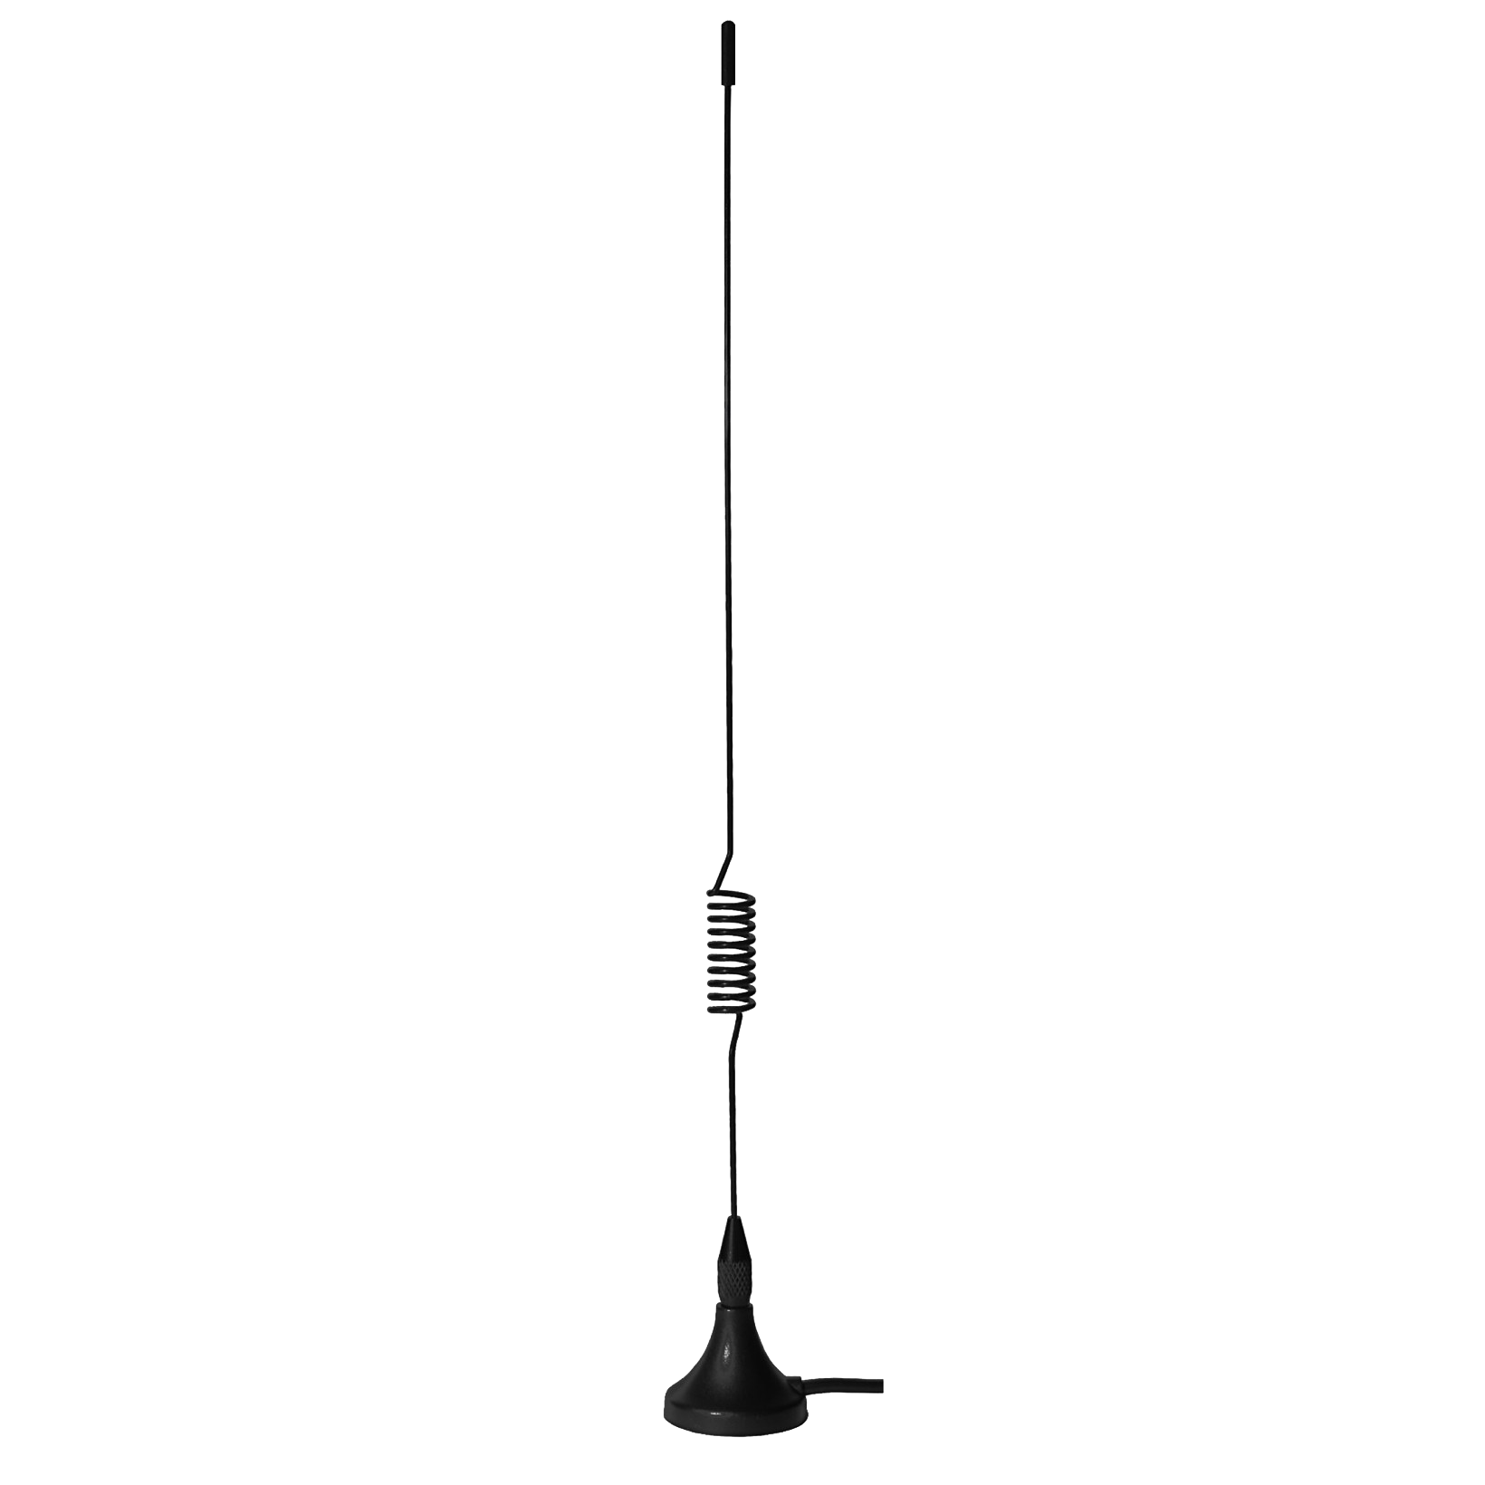
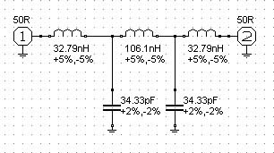
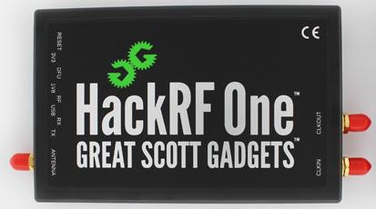
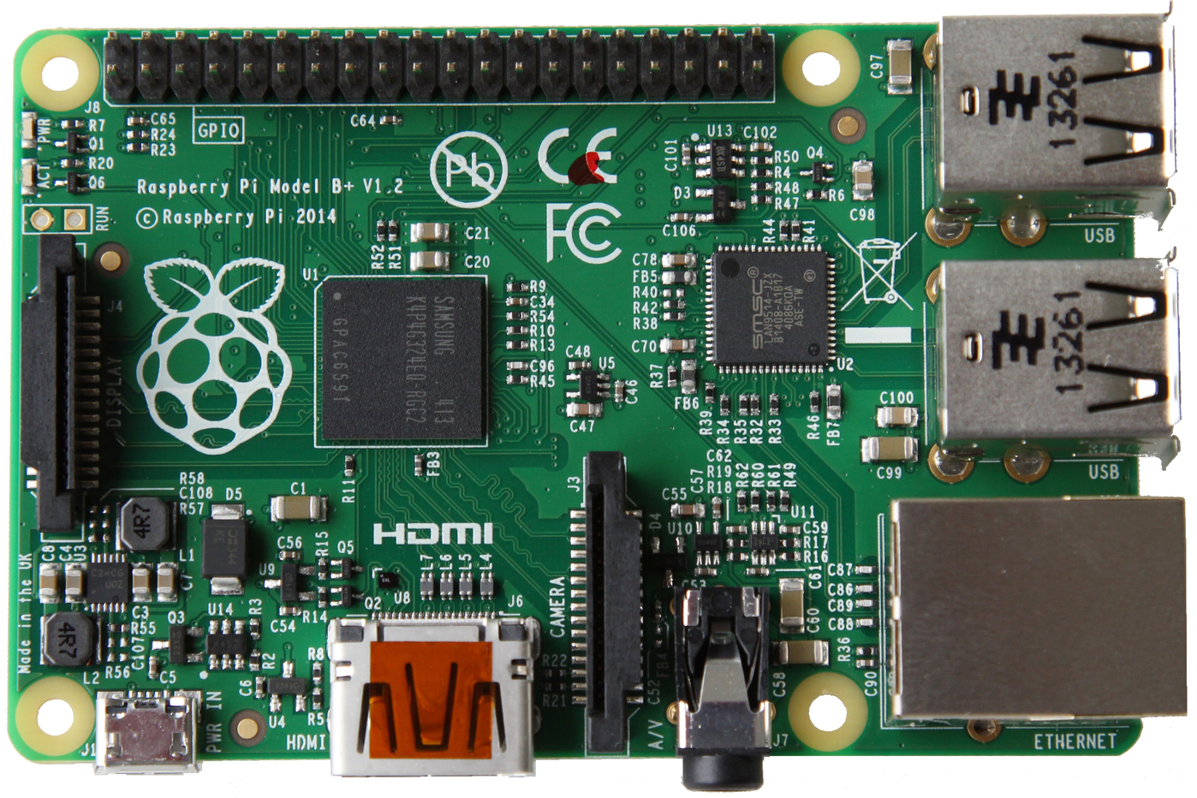
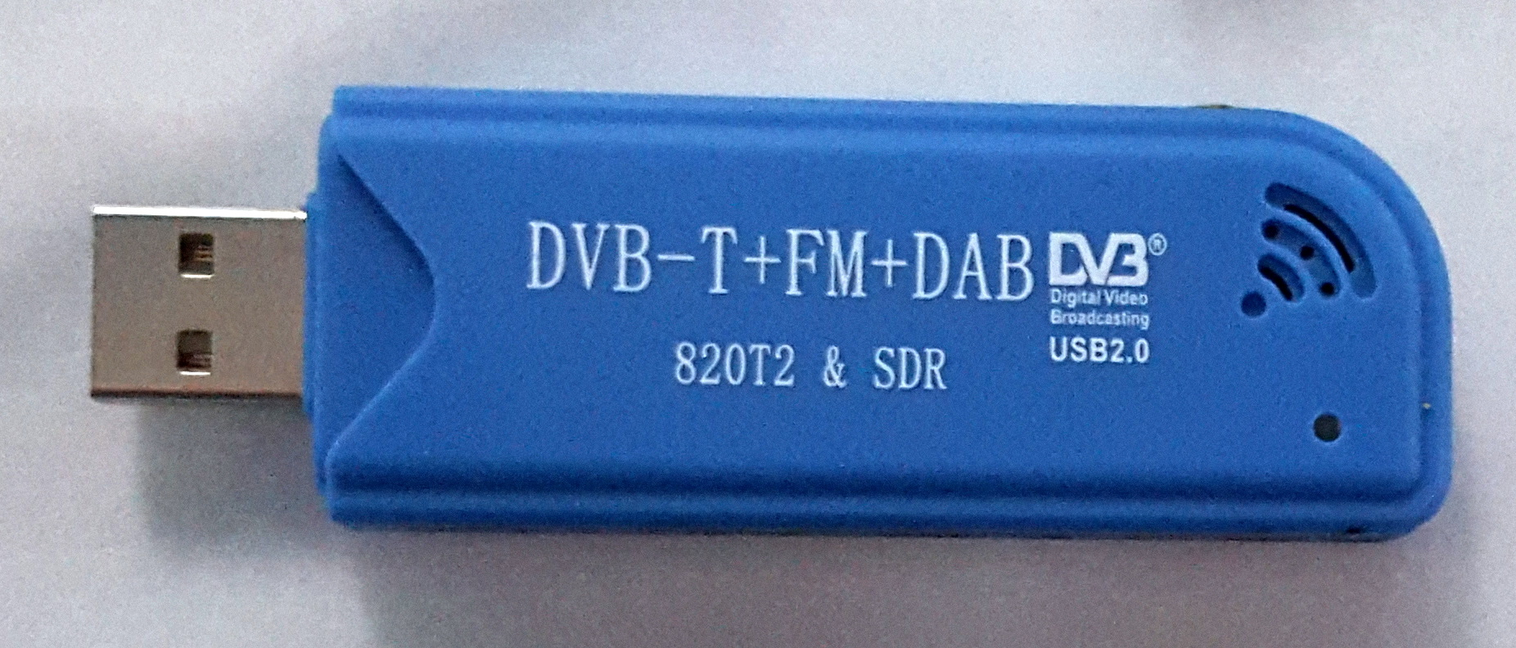
Hardware.
70cm Band
2m Band
Band Pass filter
Band Pass filter
HackRF
RaspberryPi
RTL Dongle

Slide 5
What Software do you need?
Software
Raspberry Pi Noobs or Ubuntu.
HackRF_info Utility.
Rtl_sdr Utility.
Gnuradio.
Python.
AFSK Utility.
CW Utility.

Slide 6
Block Diagram of signal process.
RTL_SDR
Receiver.
Raspberry Pi
DSP signal processor.
HackRF
Transmitter
Sensor and power Management system

Slide 7
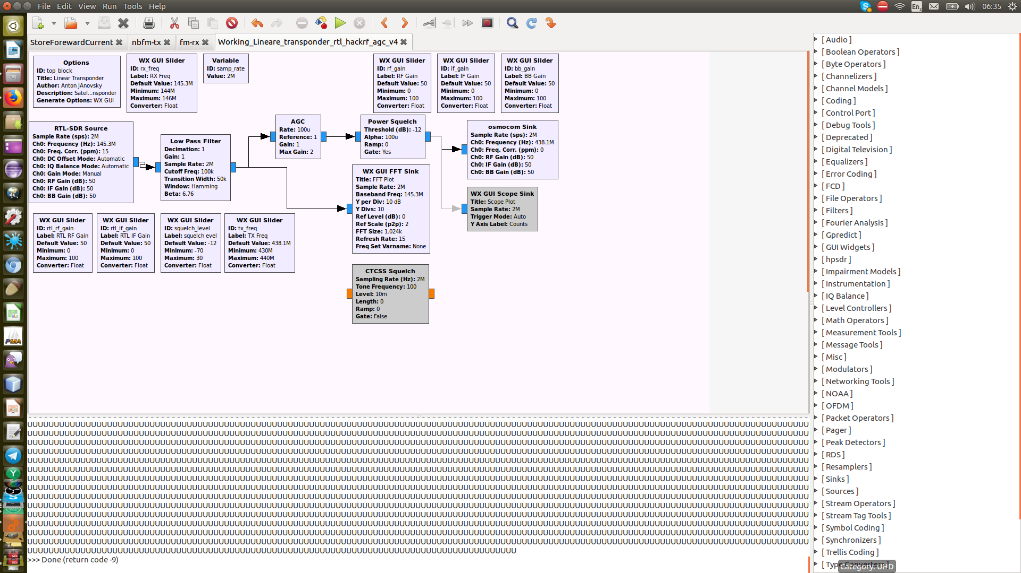
Gnu Radio Block Diagram

Slide 8
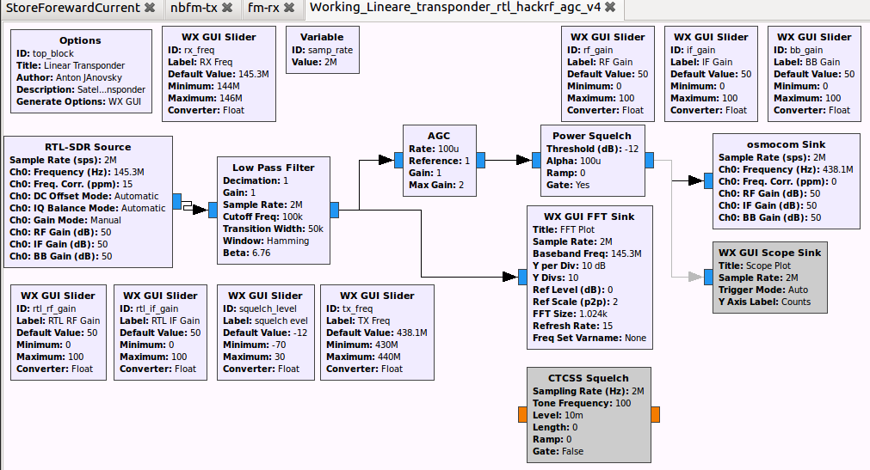
Radio Blocks
1) Input Sample Rate from RTL Dongle 2Mb
2) Input Frequency 14.300Mhz.
3) RF Gain MAX.
4) Low pass filter 100 Khz to remove A/D Noise.
5) AGC to eliminate strong and weak signals over modulation in IQ stream.
6) Power Squelch to enable TX.
7) Output Sample Rate 2Mb to HackRF.
8) Sliders and FFT for adjustments.

Slide 9
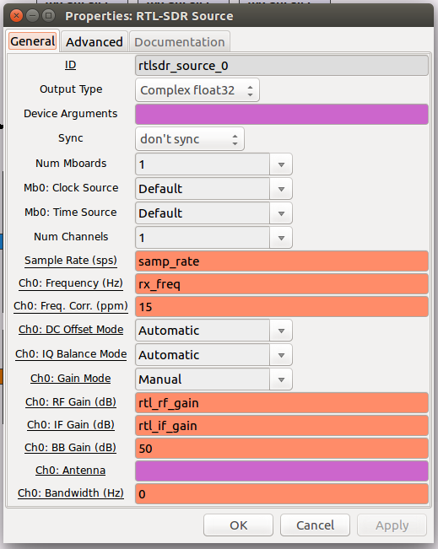
Rtl-sdr Receiving Source Block.
RTL input module.
Sample Rate 2Mb.
RX Frequency.
calibrate frequency with KAL to get ppm.
RF input gain.
RF IF gain.
BB Gain.

Slide 10
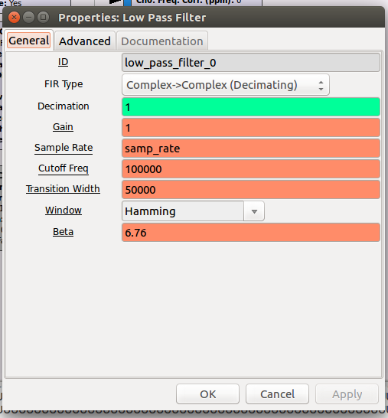
Low pass filter Block.
Low Pass filter.
Dissemination 1.
Gain 1.
Sample Rate 2Mb.
Cutoff Freq 100Khz.
Center 50kz.
Encoding Hamming.
Edge Sharpness 6.76.

Slide 11
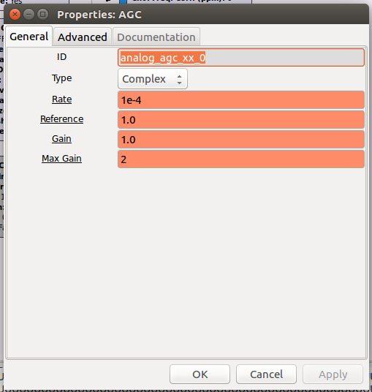
AGC Block.
AGC
Sets the rate at which the AGC can adjust the gain.
Reference: Sets the reference amplitude.
Gain:Sets the initial gain.

Slide 12
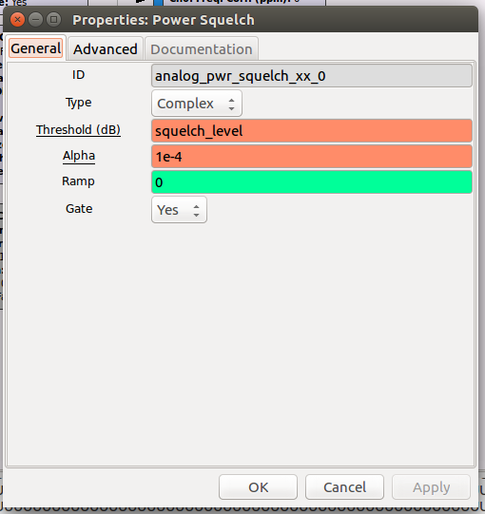
Power Squelch Block.
Power Squelch
Ramp: Sets the number of samples that the MUTED to UNMUTED and UNMUTED to MUTED transitions will occur over.
Alpha: The Alpha parameter controls the filtering of the signal's power level. The filter's difference equation is y[i] = (1-Alpha) * y[i-1] + Alpha * x[i].
Gate:Specifies whether the Squelch is gating the signal when MUTED. Will set output to zero if gate is on.

Slide 13
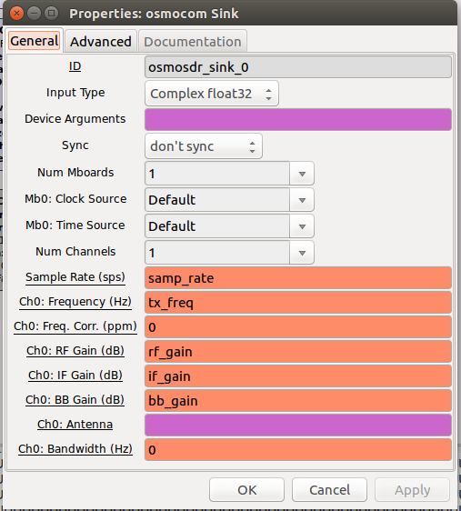
HackRF Transmitting Block (Sink).
HackRF module.
Sample Rate 2Mb.
TX Frequency 145.300Mhz.
Frequency Correction 0 ppm.
RF Gain 50.
IF Gain 50.
BB Gain 50.

Slide 14
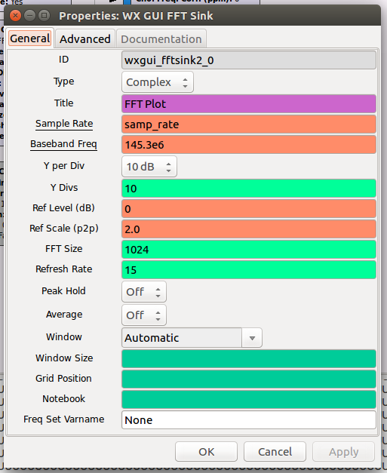
FFT View Block (Frequency domain).
FFT
Sample rate 2Mb.
Baseband freq 145.3Mhz.

Slide 15
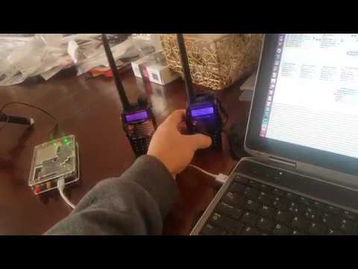
Demo Video of live system.

Slide 16
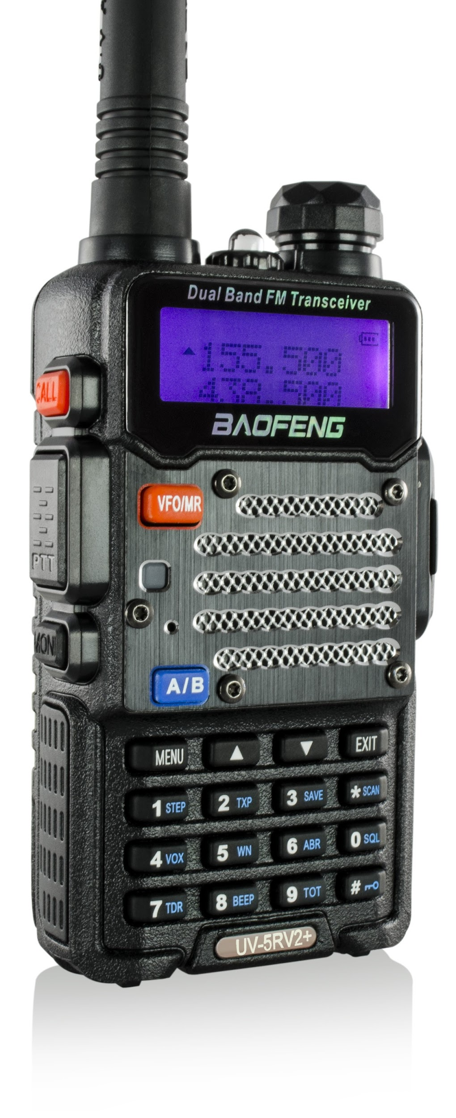
Live Demo of Transponder.
145.3
438.1
Transponder
RX 145.3Mh
Center of 100khz
TX 438.1Mh
Center of 100Khz

Slide 17
Questions?

